Slide 1
Angular Questions

Slide 2
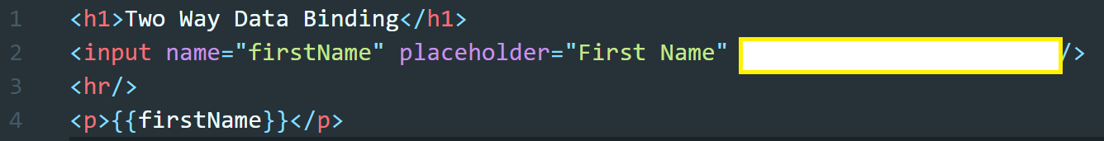
What is missing to enable two-way data binding?

Slide 3
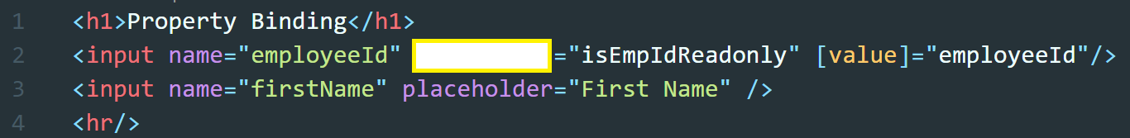
What is missing to make the below field non-editable?

Slide 4
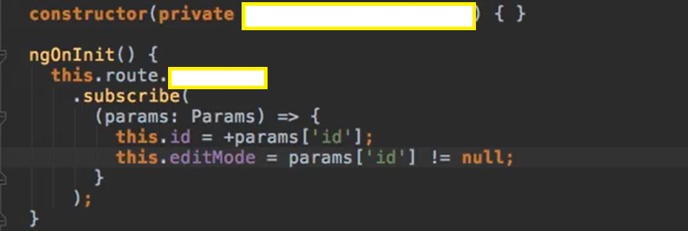
What is/are missing in the below snippet?

Slide 5
Done

